Slide 1

Character Recognition for Offline Telugu Script Digitalized Images
BATCH NO: A8 GUIDE:
Bhargavi Lakshmi B [154G1A0509] Mrs. SAILAJA S L M.Tech(Ph.D)
Akshaya M [154G1A0503] Assistant Professor
Mounika P S [154G1A0551]
Nandini A [154G1A0556]
Srinivasa Ramanujan Institute of Technology
Department of Computer Science & Engineering

Slide 2
Contents
Abstract
Problem Statement
Project Planning
Related Work
Literature Survey
Requirements
References

Slide 3

Abstract
Telugu is the language spoken by more than 100 million people of South India. Telugu script, consists of rounded characters with no horizontal and vertical lines as in Hindi script.
Here, in our project, character dataset is generated with Telugu scripted digitized images, an offline approach.
Any digitalized telugu character image will be captured, perform segmentation, preprocess the segmented character, pattern match with the dataset and identify the characters/words/lines/paragraphs.
The scope of our Project is to recognize the character ‘ ’.

Slide 4
Problem Statement
There are so many plug-ins to convert Image to text for Telugu language in Online. There is no application as such which supports the recognition of Telugu characters from the scanned image in offline.
Our aim is to recognize the characters from the digitalized telugu scripted image and converting into the text in an offline approach.

Slide 5
Project Planning
Time Schedule:
Week-1: Software Installation and Requirements Gathering.
Week-2: Analysis and Design.
Week-3: Implementation
Week-4: Testing
Week-5: Documentation and verification.

Slide 6
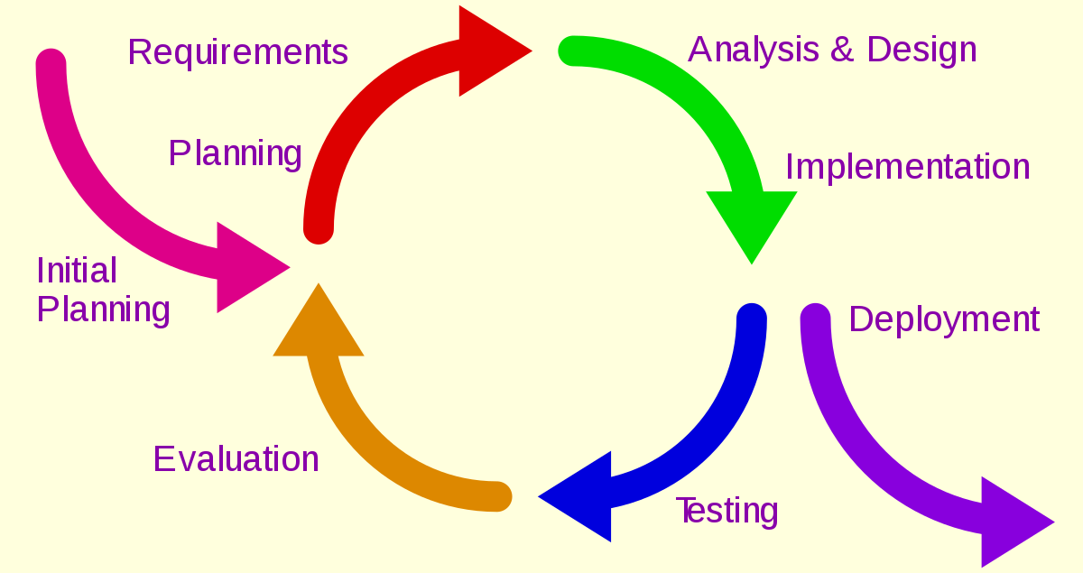
Planning Model: Iterative Model

Slide 7
Iterative Model
The iterative model is best thought of as a cyclical process.
This is the crux of the entire iterative model, whereby the most recently built iteration of the software, as well as all feedback from the evaluation process, is brought back to the planning, development stage at the top of the list, and the process repeats itself all over again.

Slide 8
Related Work
Few Algorithms that are used in recognizing the characters are
- K-NN Algorithm
- Support Vector Machine
- Genetic Algorithm
- Hidden Markov Model
- Artificial Neural Networks
- Decision Tree
- Naive Bayes

Slide 9
Literature Survey
Optical character recognition(OCR) is a well known process for converting text images to machine editable text format.
Many research groups has developed OCR systems for English and achieved high level of accuracy in combining the OCR in both online and offline.
Image to Text synthesis for regional languages is still an open challenge, due to variations in writing styles even within the same script.

Slide 10
Contd..
Limitations of Existing System
In particular the research done in OCR for Telugu language is not significant. Still, OCR for regional languages lack accuracy.
Accessing the text documents and reading them on the go is still troublesome task for the people with the changing socio-economic requirements.
There is no application as such which supports the recognition of Telugu characters from the digitalized image in offline.

Slide 11
Contd..
Proposed System
This project is an attempt to recognize the character of digitalized images of Telugu language in Offline.
Generation of Dataset with digitalized images of Telugu script.
Prior to Image capture, a dataset of Telugu characters has to be generated. Further, the steps for character recognition after capturing text images is as below:

Slide 12
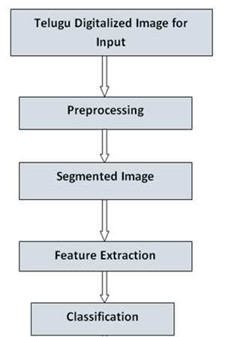
Contd…

Slide 13
Requirements
Software Requirements:
Operating Systems – Windows, Linux, Mac
Platform – Python 3.7
Programming in - Python
Hardware Requirements:
RAM Capacity – 192 MB

Slide 14
References
http://cs229.stanford.edu/proj2011/Moparti%20OCR%20for%20telugu%20script.pdf
https://www.cse.iitb.ac.in/~saketh/research/rajeshMTP.pdf
http://shodhganga.inflibnet.ac.in/bitstream/10603/4166/13/13_chapter%20%205.pdf

Slide 15
Thank you
Queries
?

Slide 16
Comments in previous review:
Scope of the project
Algorithm used
Clarity on the phases to be involved

